Slide 1

FIA DATA CENTER
Behzad Hassan
Ayaz Hussain
Ameer Din

Slide 2

Introduction
FIA: Vital for law and security in Pakistan.
Project: FIA Data Center Management System.
Goal: Centralized database for personnel, investigations, resources.
Purpose: Streamline data handling for improved efficiency.
Impact: Revolutionize FIA's data management, enhancing effectiveness.
System Architecture client-server model

Slide 3
System Components Overview
Frontend (GUI): PyQt6 interfaces for user interaction.
Backend: Python logic for data processing and MySQL interaction.
Database: MySQL stores personnel, investigation, and asset data.
Client-Server: JSON model for frontend-backend communication.

Slide 4



Database Tables Overview
Main Tables:
1. Person:
2. Crimes:
3. Jail Details:
Stores personal information of FIA personnel.
Includes fields for name, date of birth, gender, nationality, etc.
Crime Record:
Manage information about crimes and associated records
Jail Record
Track details of jails and associated records

Slide 5
Database Tables Overview
Emails, Phone_numbers, Addresses: Store contact details of individuals.
Education, Employment: Record educational and employment history.
Property ,
Manages FIA assets like properties and their details.
Contains fields for property type, address, registration ID, etc.
Vehicles:
Tracks vehicles owned by FIA personnel.
Includes fields for vehicle make, model, year, registration number, etc.

Slide 6
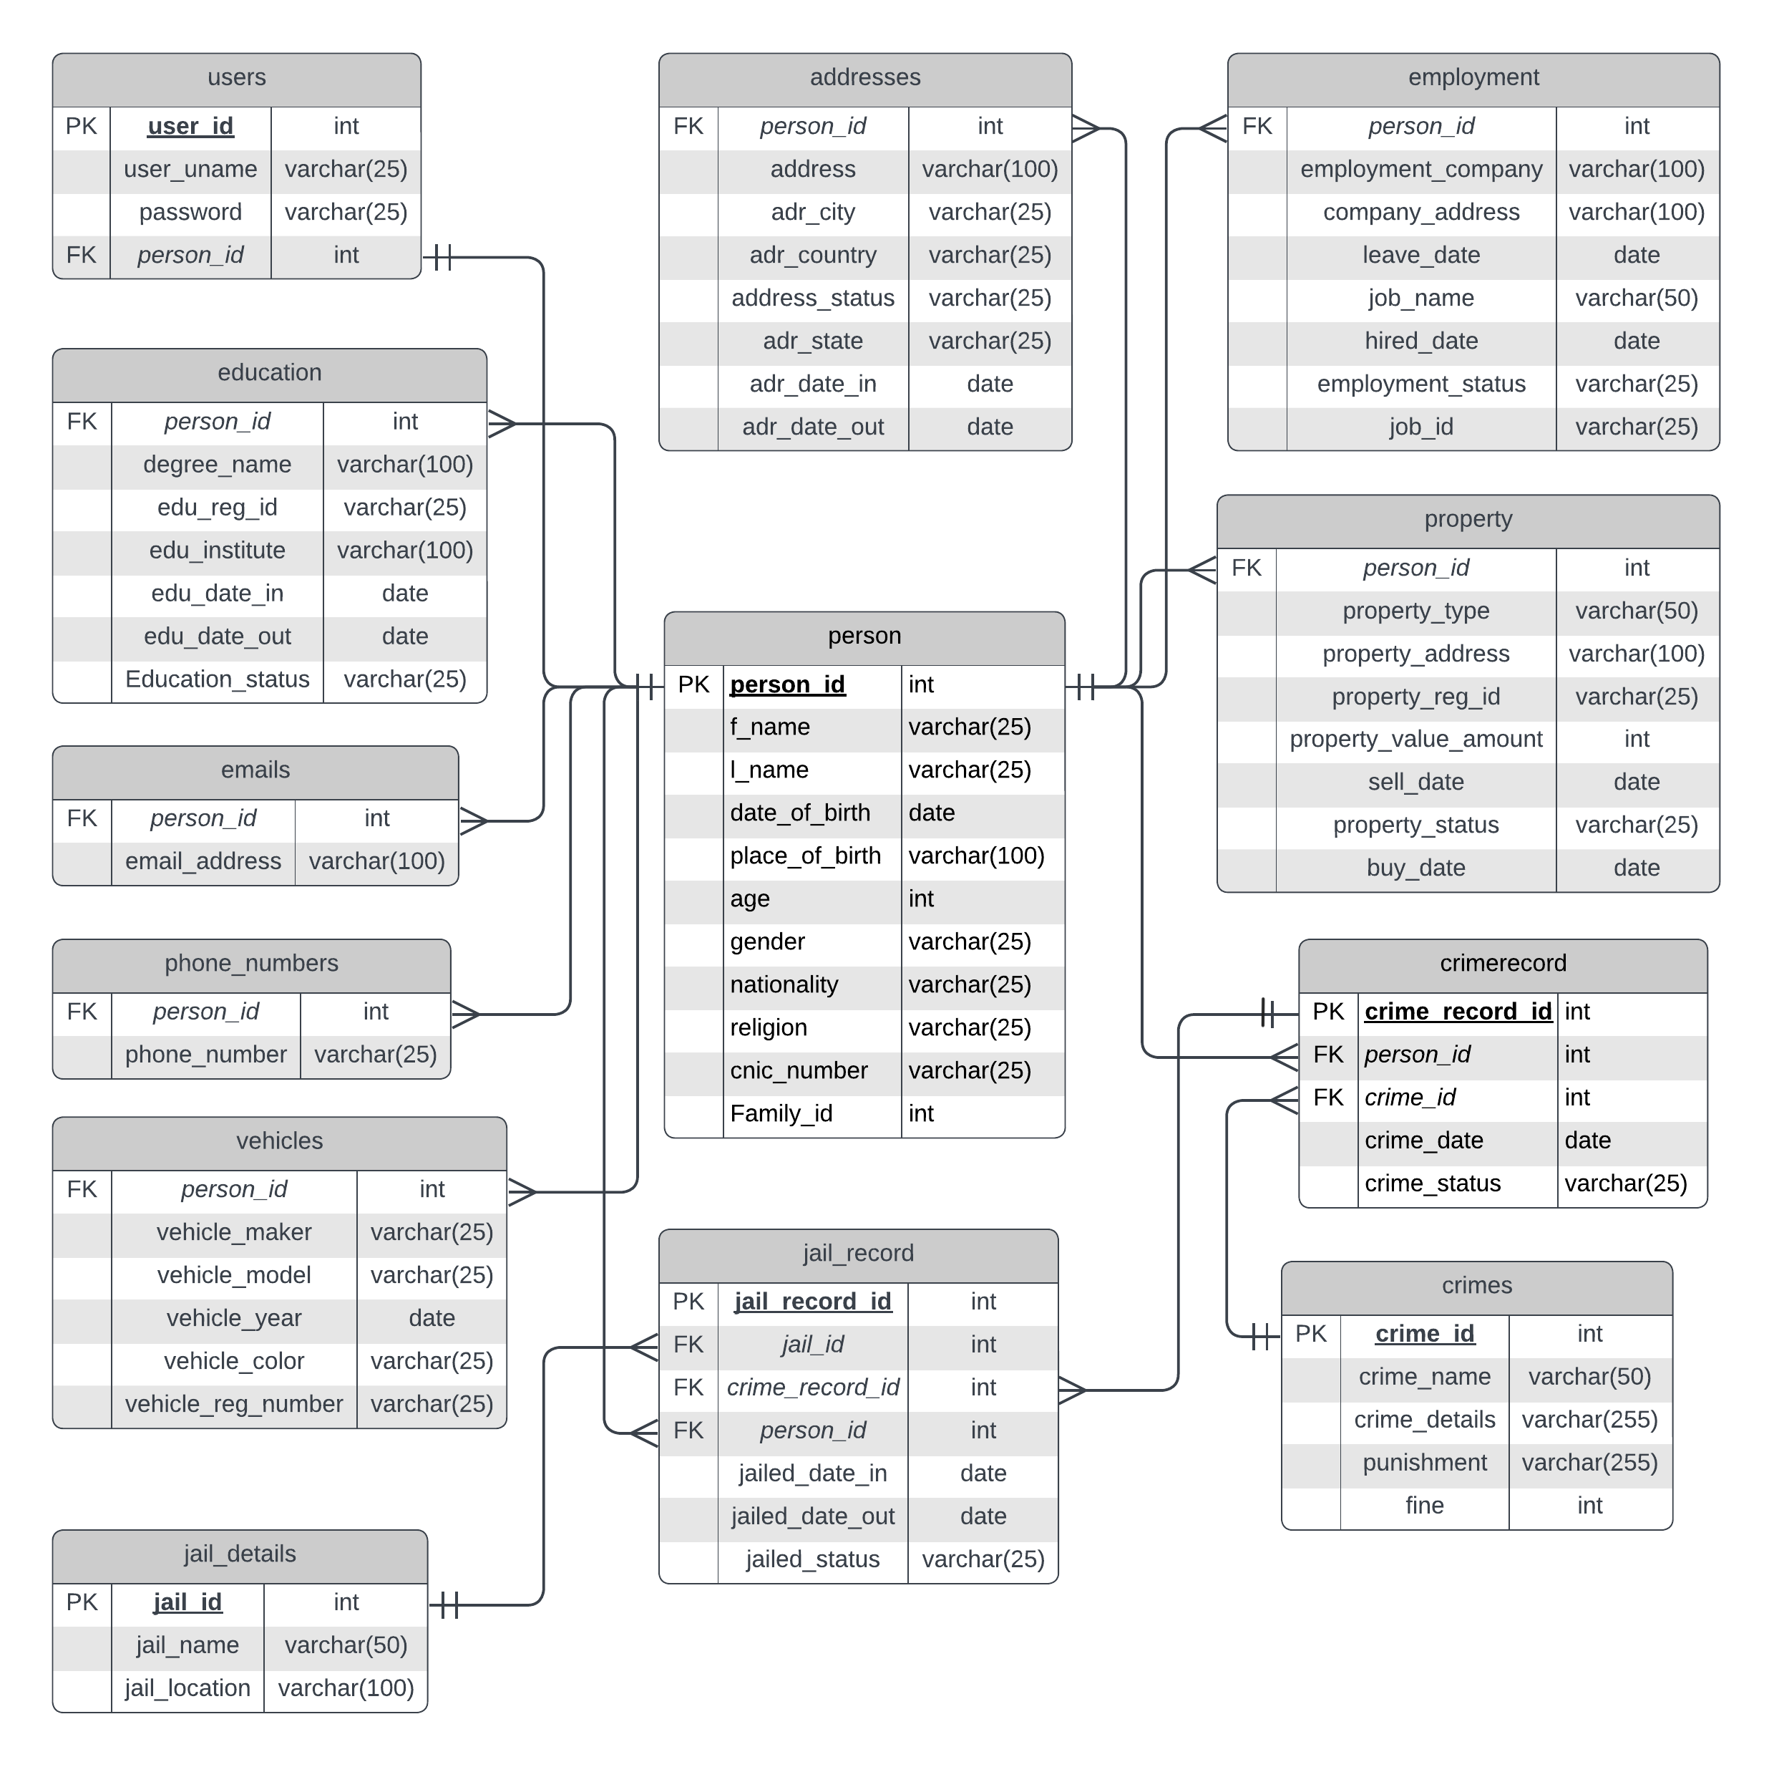

Slide 7
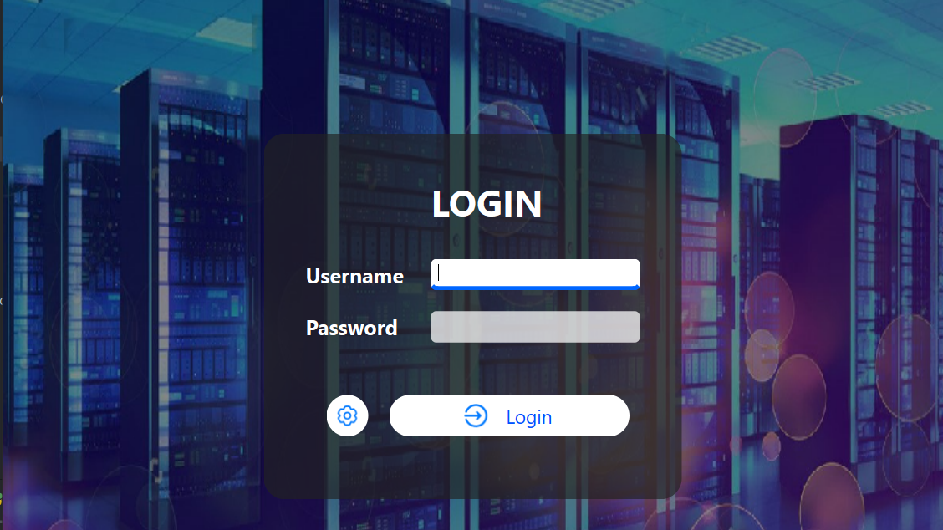

Slide 8
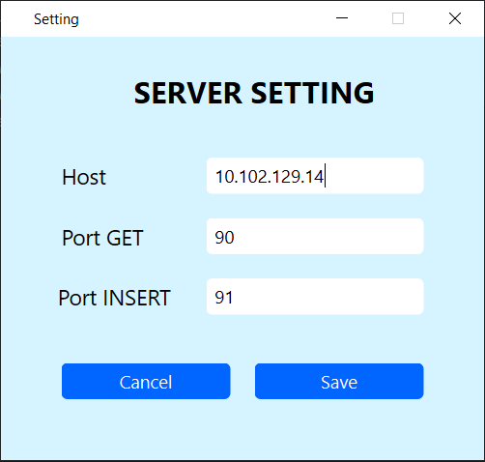

Slide 9
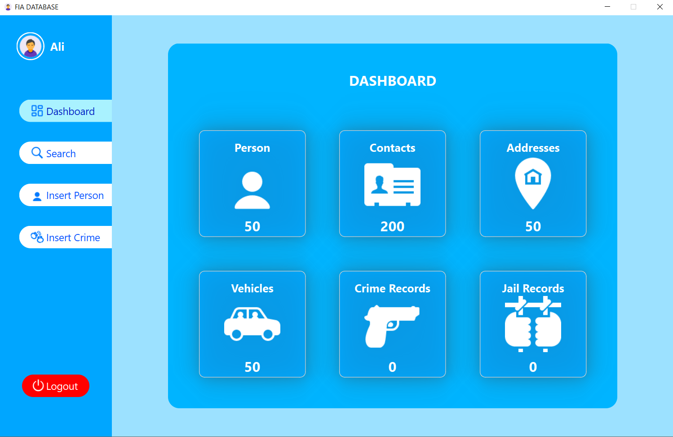

Slide 10
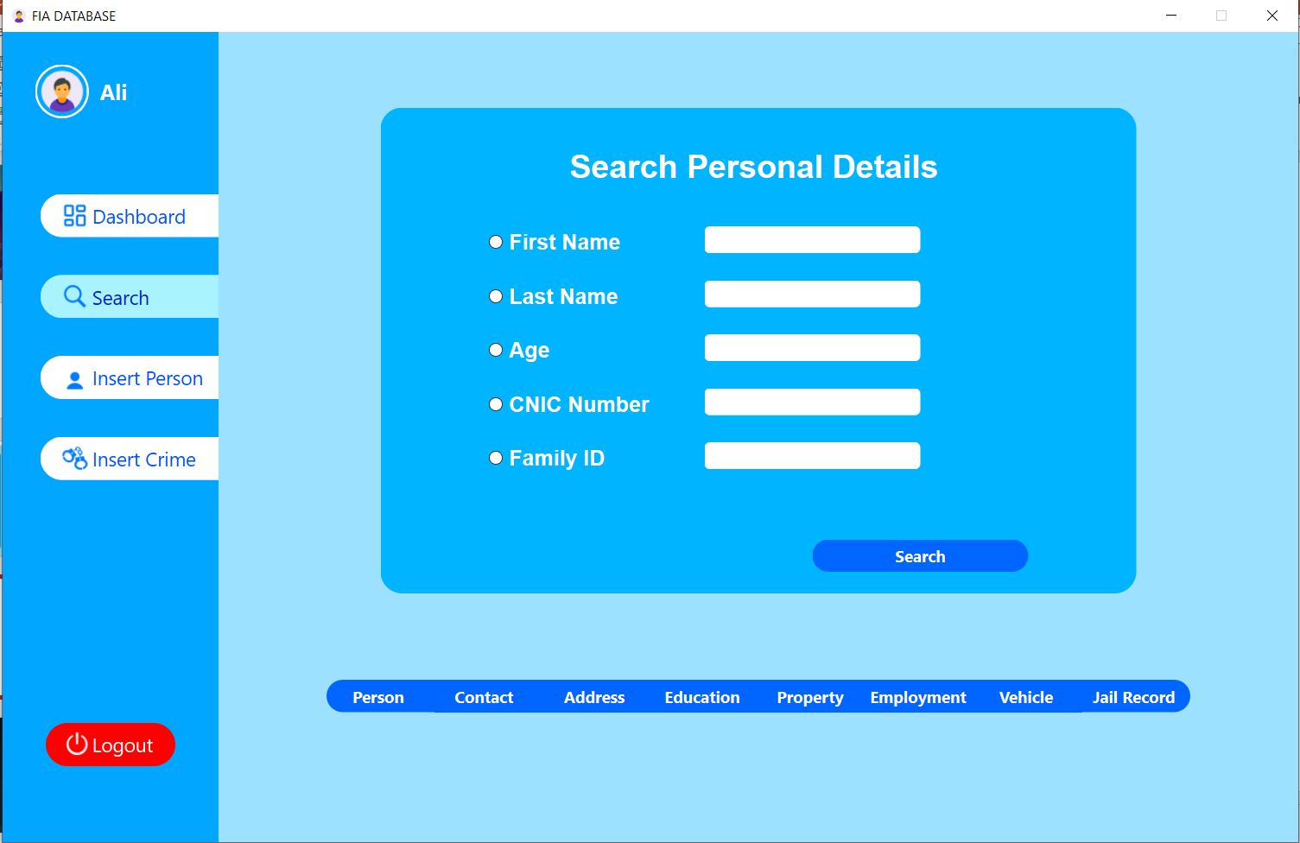

Slide 11
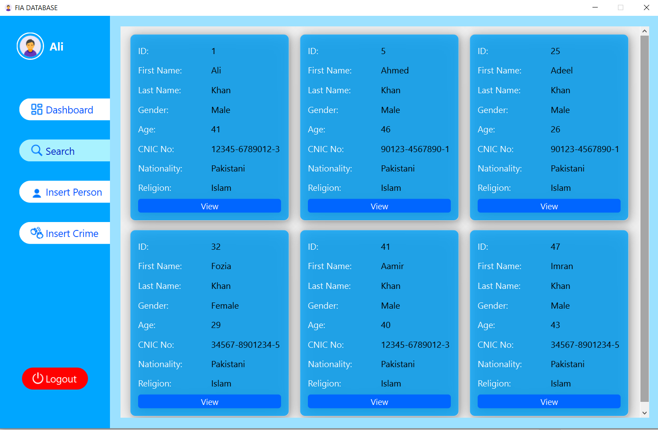

Slide 12
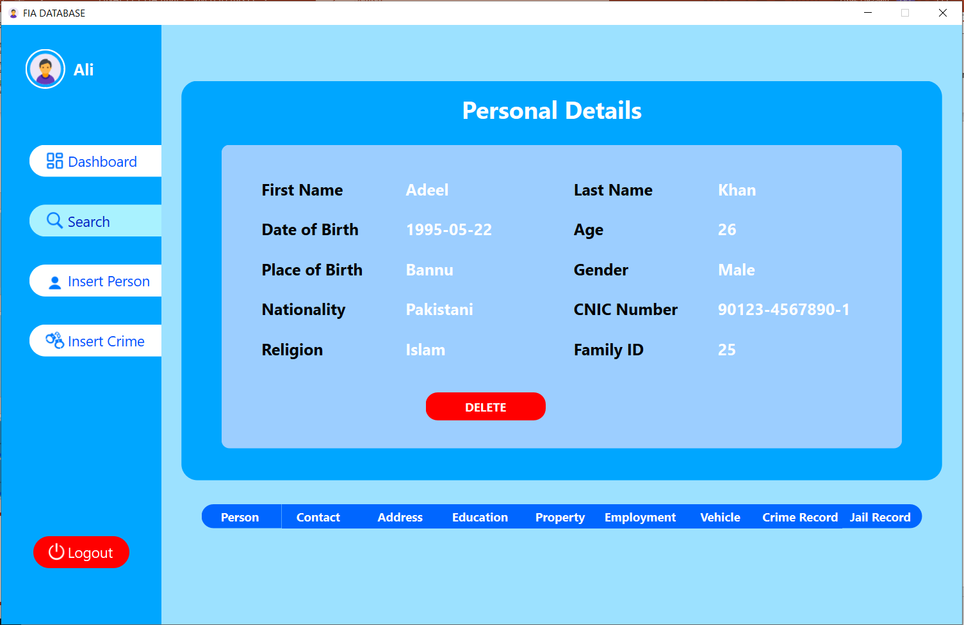

Slide 13
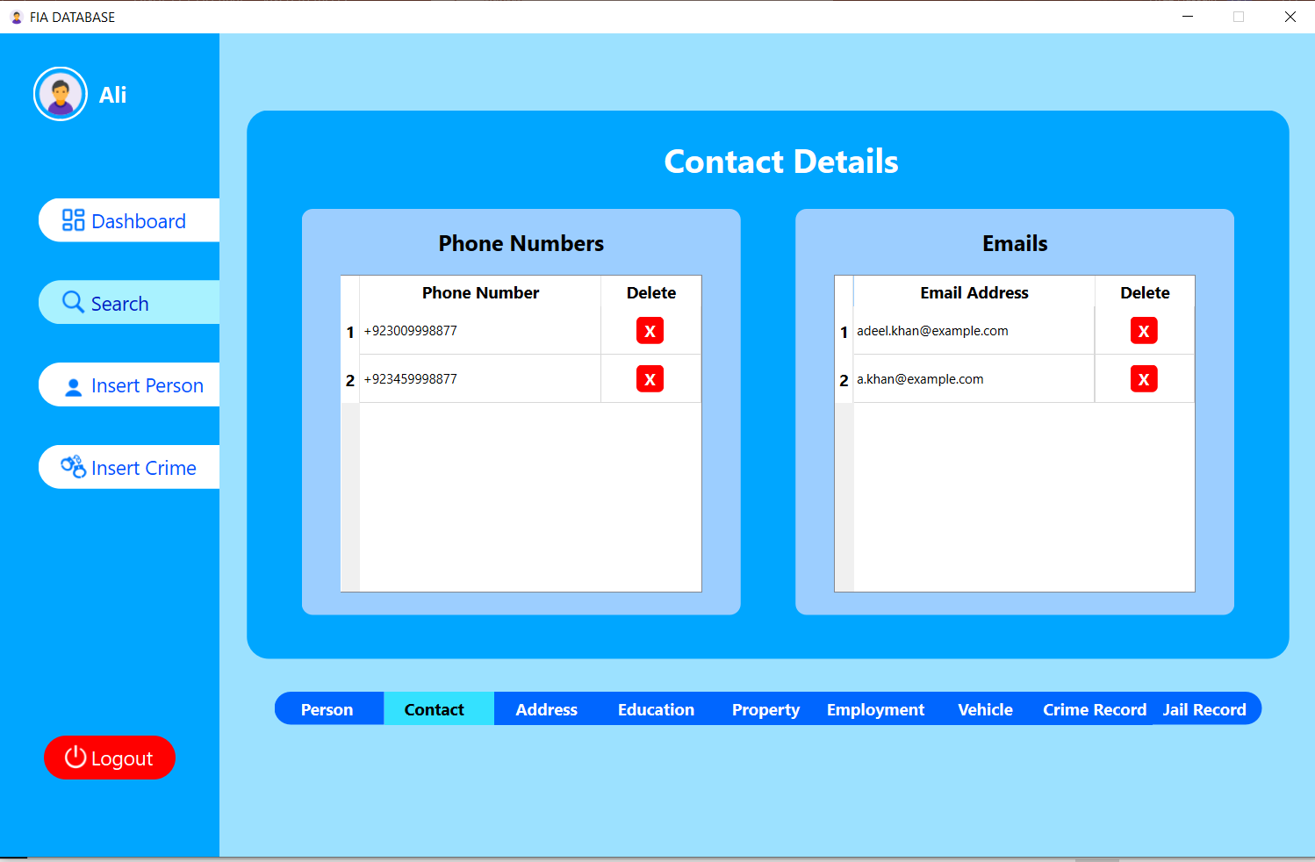

Slide 14
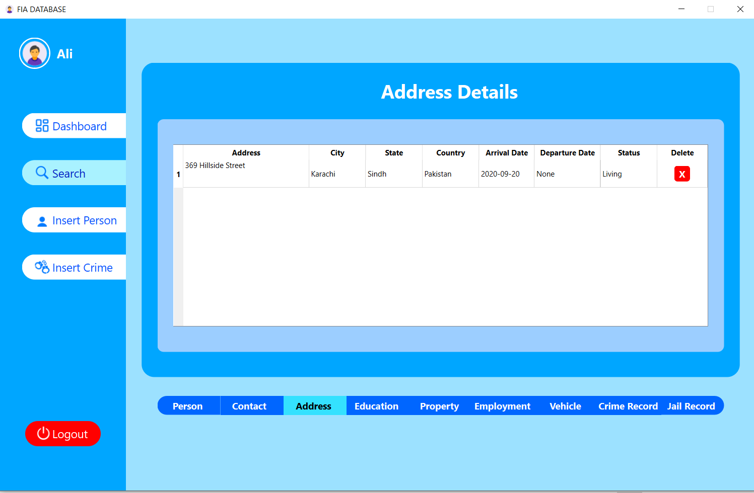

Slide 15
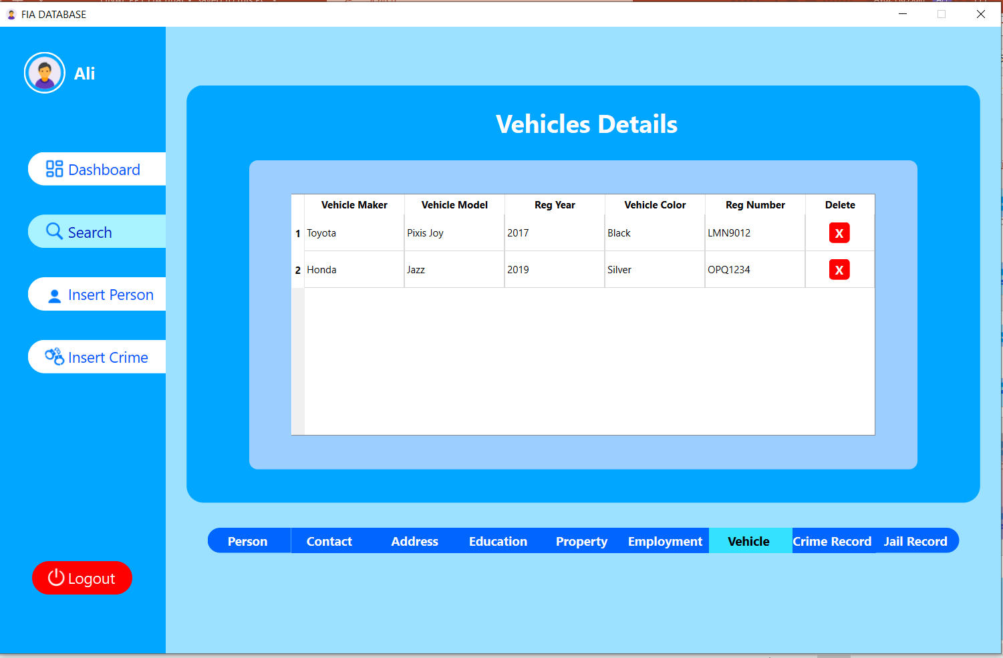

Slide 16
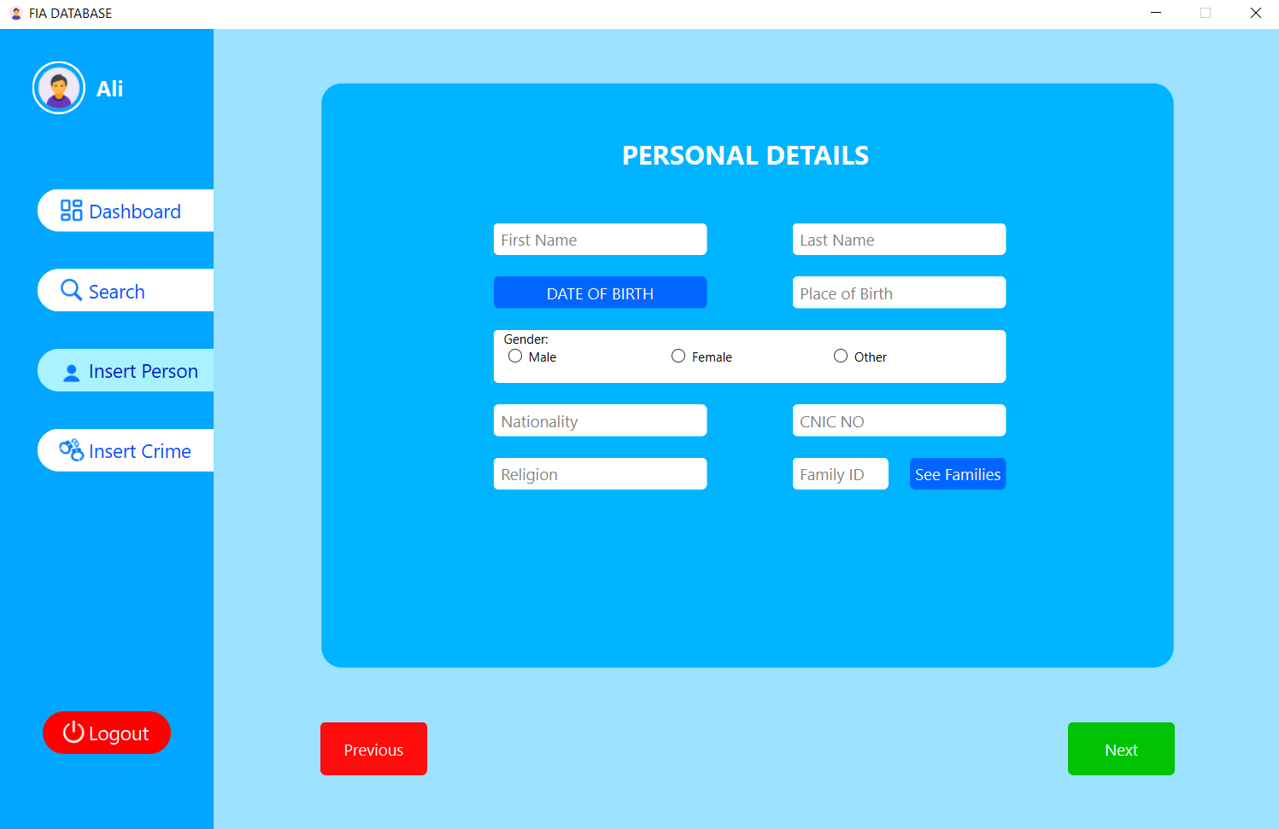

Slide 17
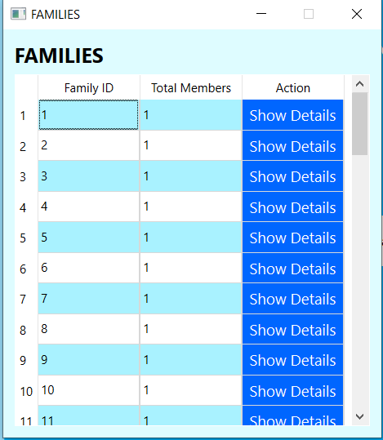

Slide 18
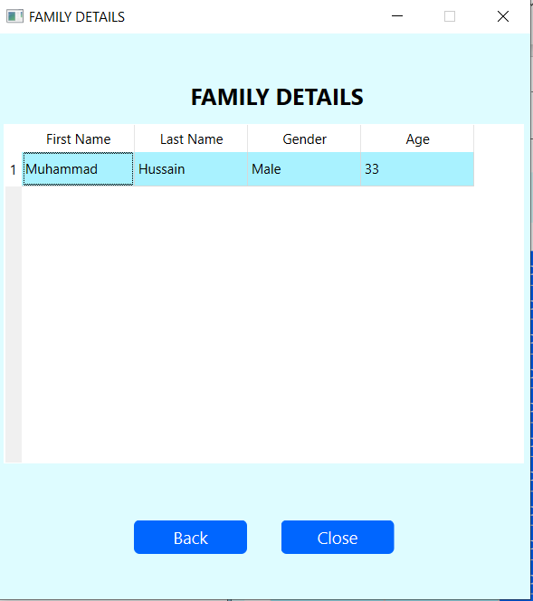

Slide 19
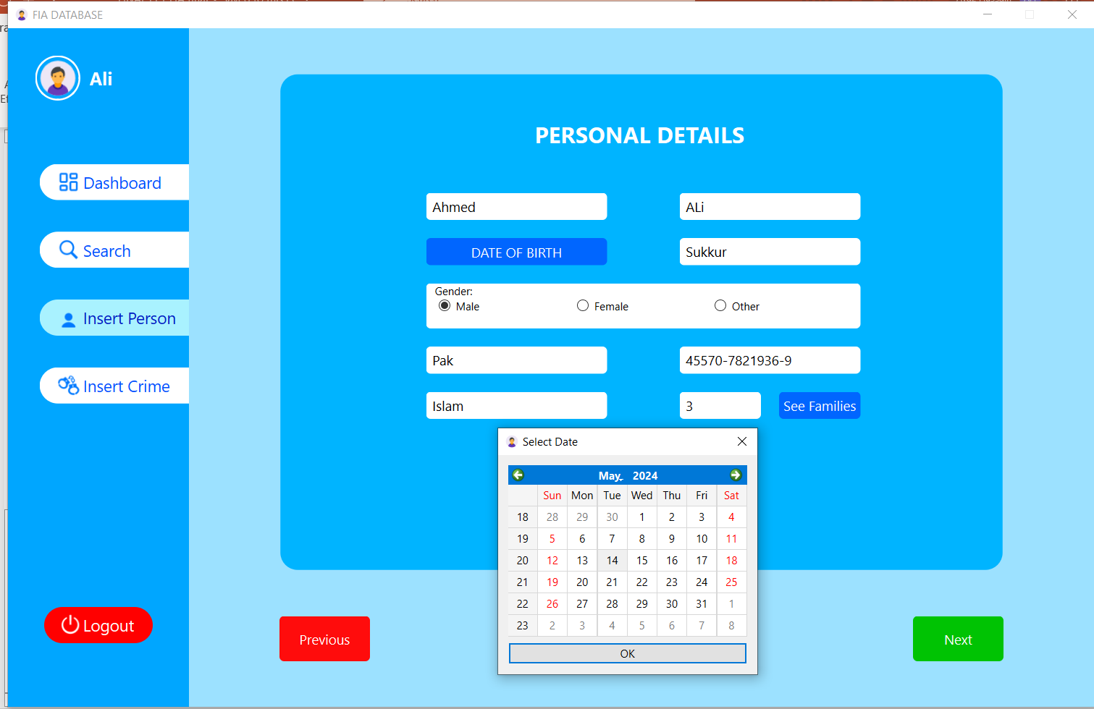

Slide 20
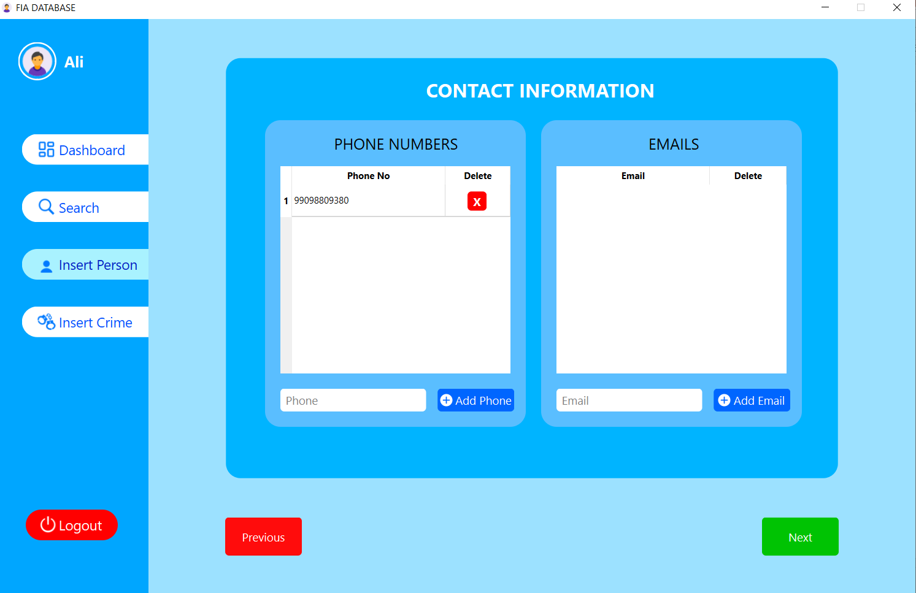

Slide 21
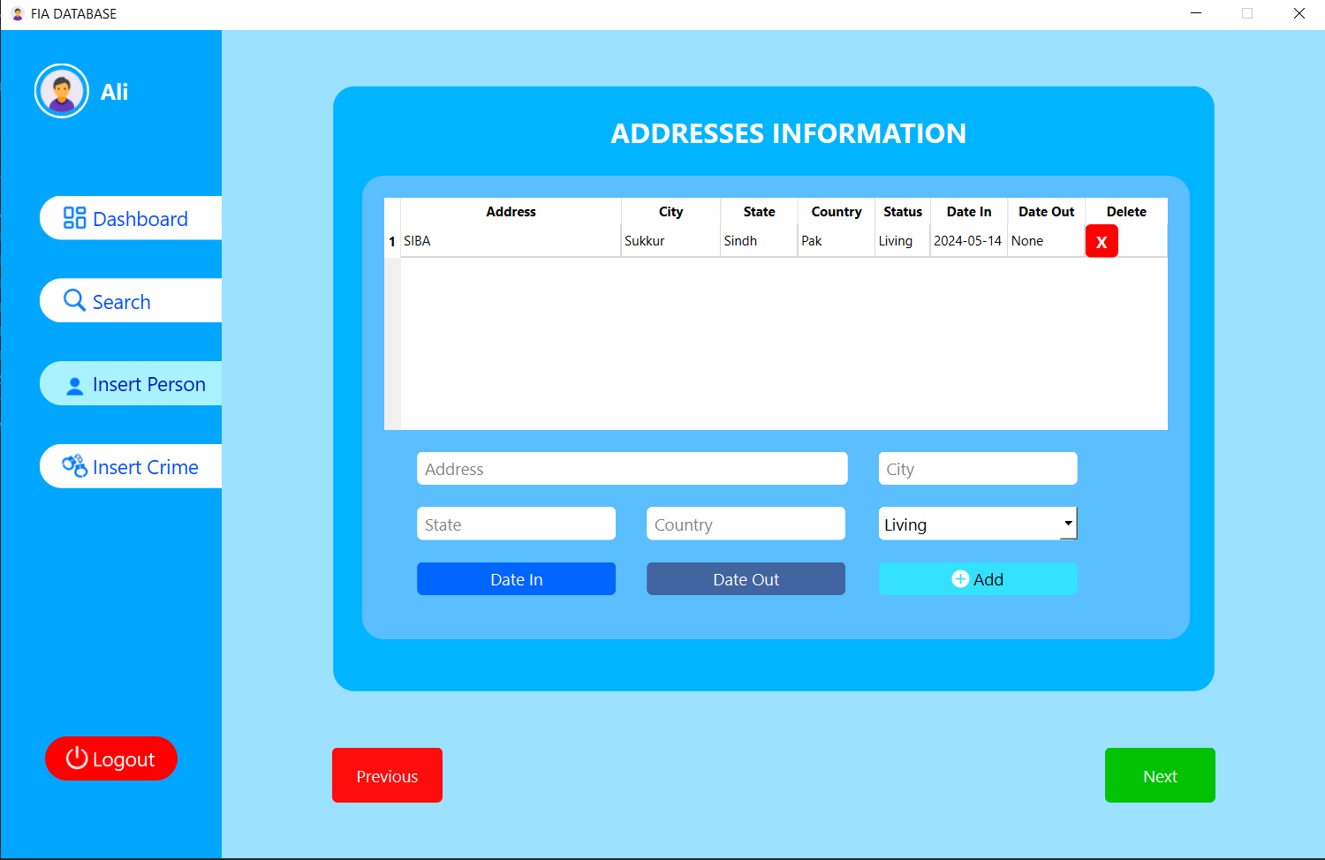

Slide 22
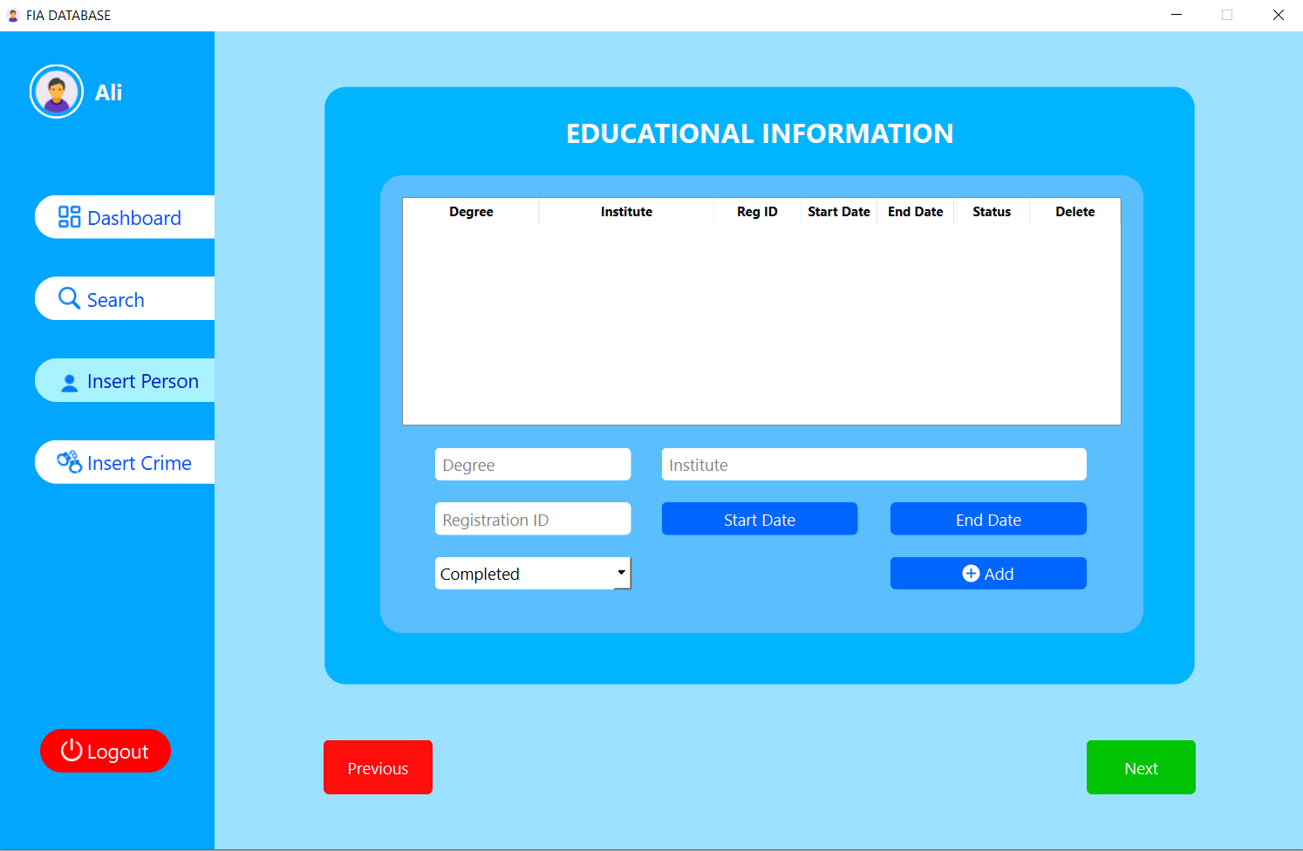

Slide 23
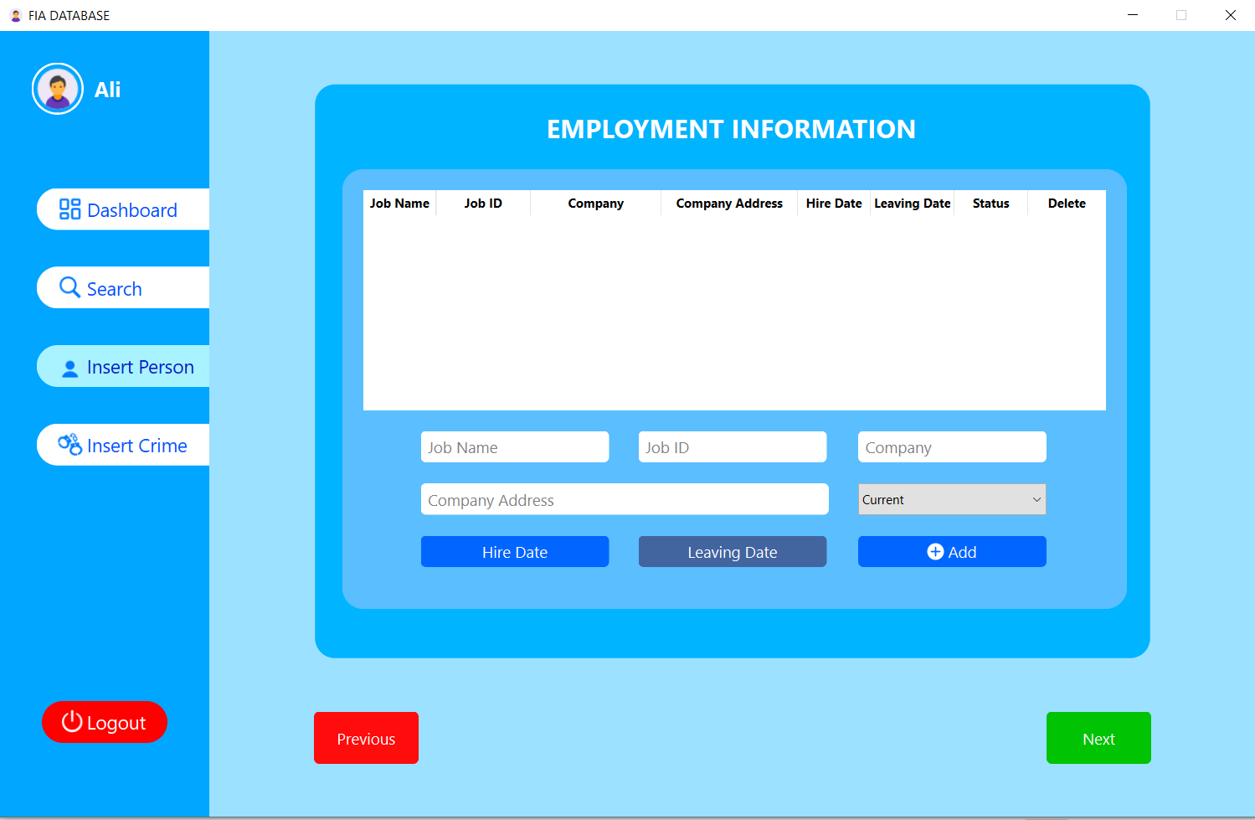

Slide 24
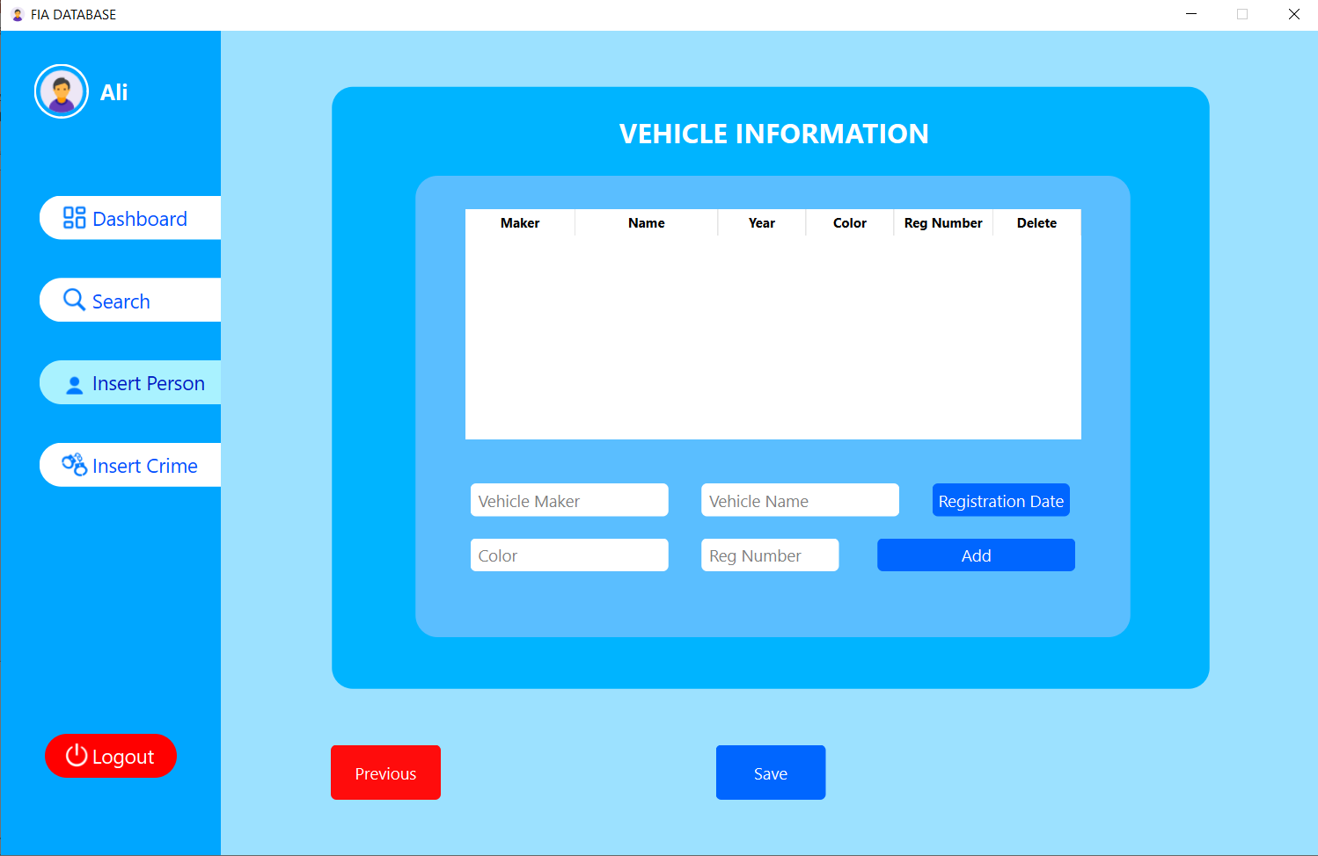

Slide 25
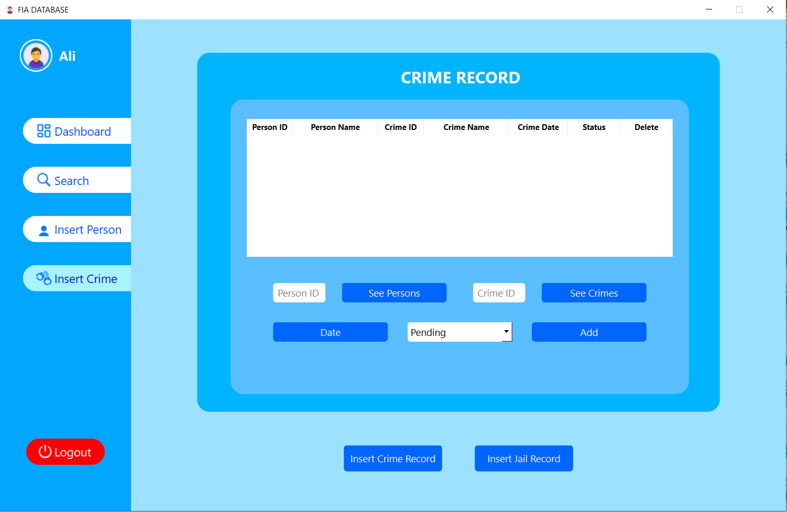

Slide 26
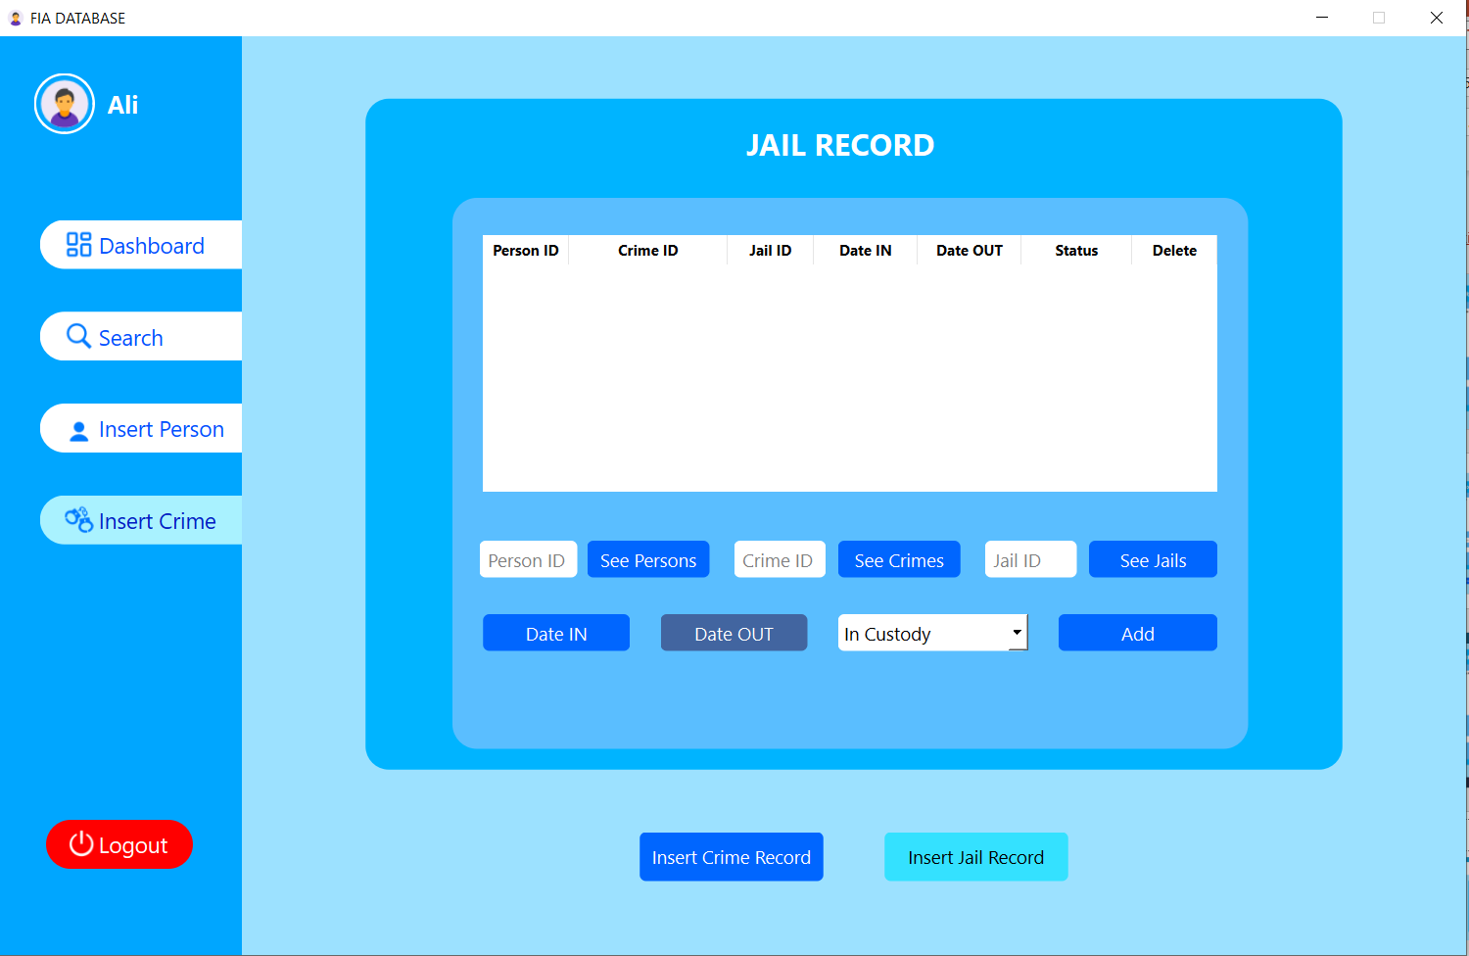

Slide 27
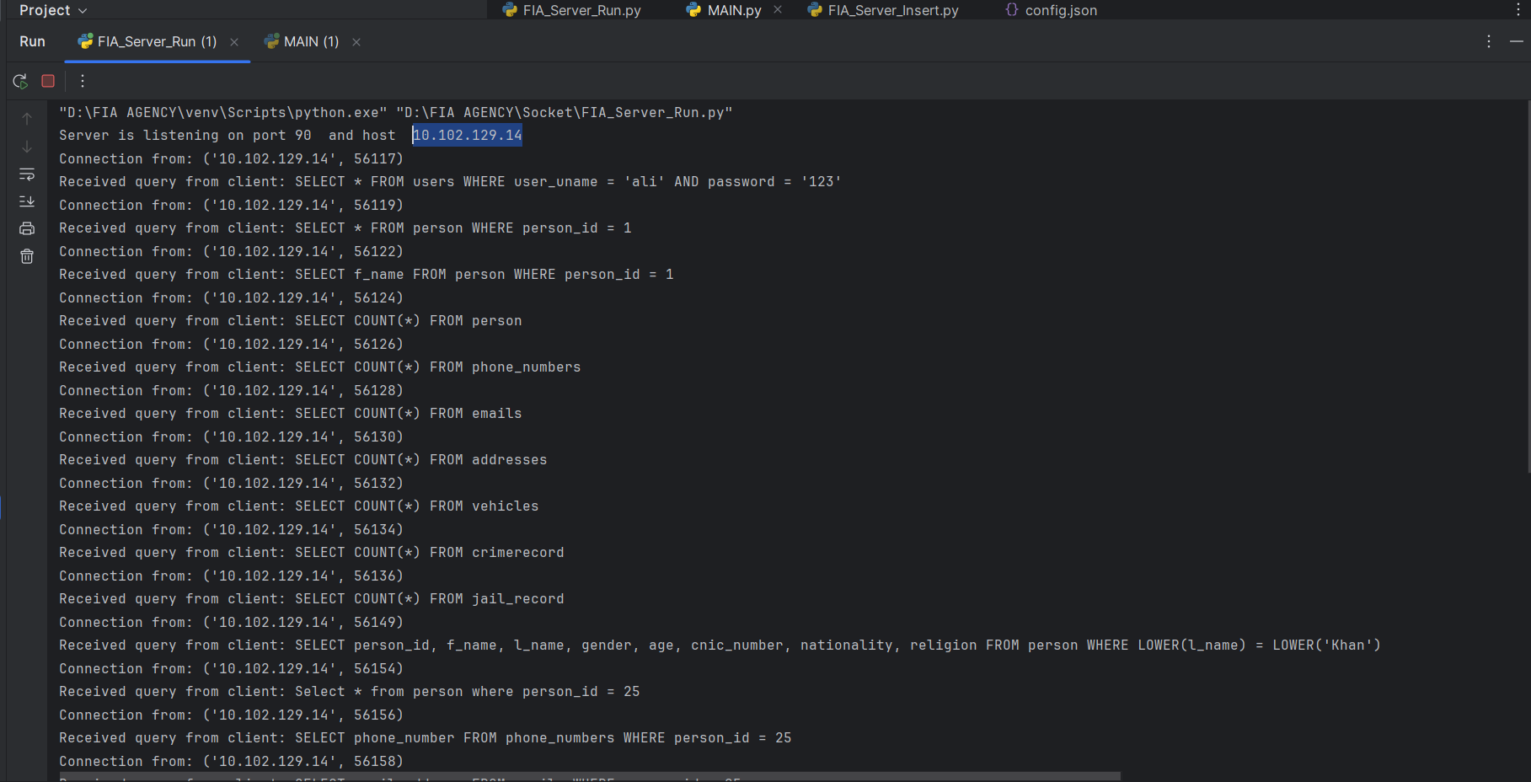

Slide 28
THANK YOU

